Slide 1
Parts Of A Flower- Structure and Function
-Mohammad Amaan Siddiqui-

Slide 2
Lesson Objectives
Identify the reproductive parts of a plant and correlate the parts with its functions
Differentiate between unisexual and bisexual flowers.

Slide 3
What is a flower?
Plant organ for sexual reproduction
Flowers produce gametes (sex cells)
Flowers are necessary for fertilization to occur

Slide 4
Introductory Activity
What are Cryptogams?
What are Phanerogams?
What are Angiosperms?
What are Gymnosperms?

Slide 5
Label the Following Parts
Style, stamen, sepal, filament, peduncle, ovary, anther, receptacle, carpel, stigma, petal, ovule.

Slide 6
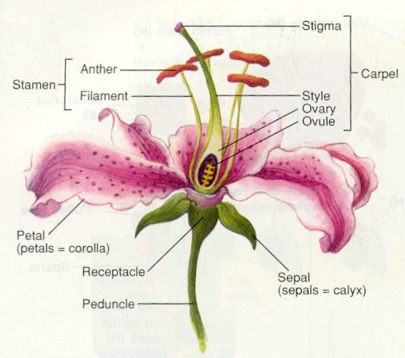
Parts of a Flower

Slide 7
Flower Dissection Activity

Slide 8
Functions of the parts of flowers
Pistil/Carpel: female part of the flower, consist of the stigma, style and ovary
Ovule: located in the ovaries, carry female gametes
Staminate flower: flower bearing only male parts
Pistillate/Carpellate flower: flower bearing only female sex parts
Hermaphrodite flower: flower bearing both male and female sex parts
Peduncle: flower stalk
Receptacle: part of stalk bearing the floral organs, at base of flower
Sepal: leaflike structures at flower base, protects young flower bud
Calyx: all the sepals together form the calyx
Petal: located inside and above the sepals, often large and colourful, sometimes scented, sometimes producing nectar
Stamen: male part of the flower, consist of the anther and filament, makes pollen grains
Pollen: grains containing the male gametes

Slide 9
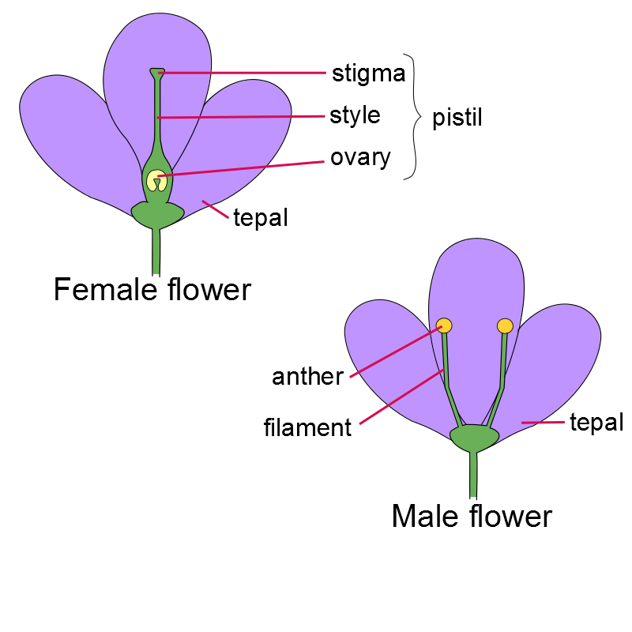
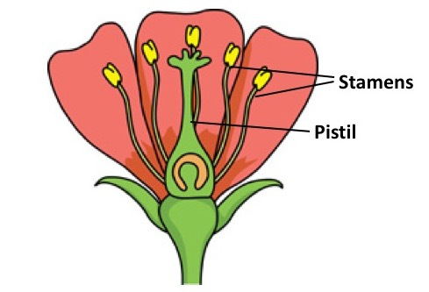

Slide 10
Group Activity (BYOD Permitted)
How do pollen grains stick to the Anther? (1,2)
Is there any chances for crosspollination in a bisexual plant? Justify. (3,4)
What are the factors contributing to the decline of pollinator population? What effect will it have on the food crop industries? (5,6)

Slide 11
Quizizz
Quizizz.com/join
And enter with given code.

