Slide 1
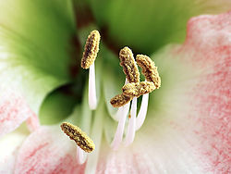
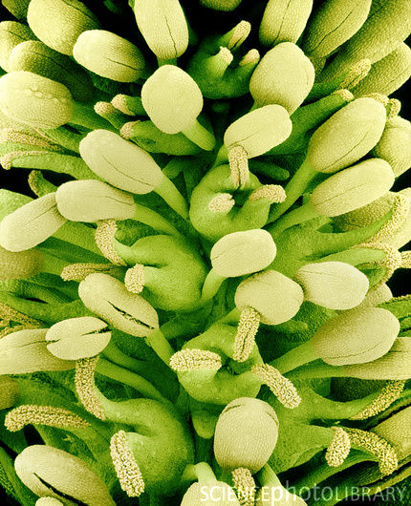
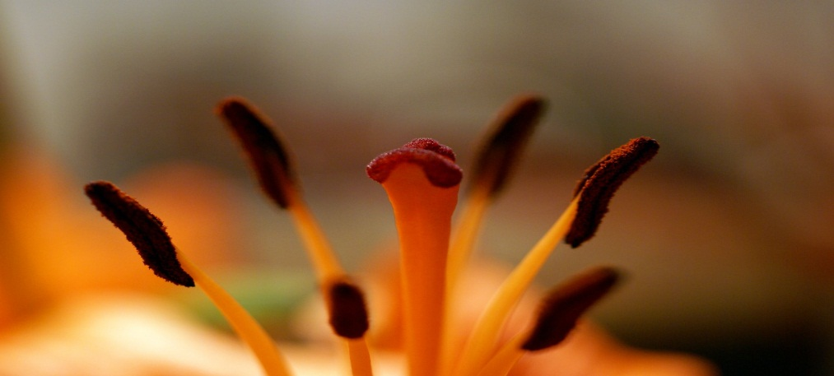
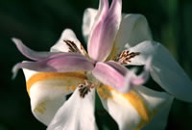
Sexual Reproduction In Flowering Plants

Slide 2
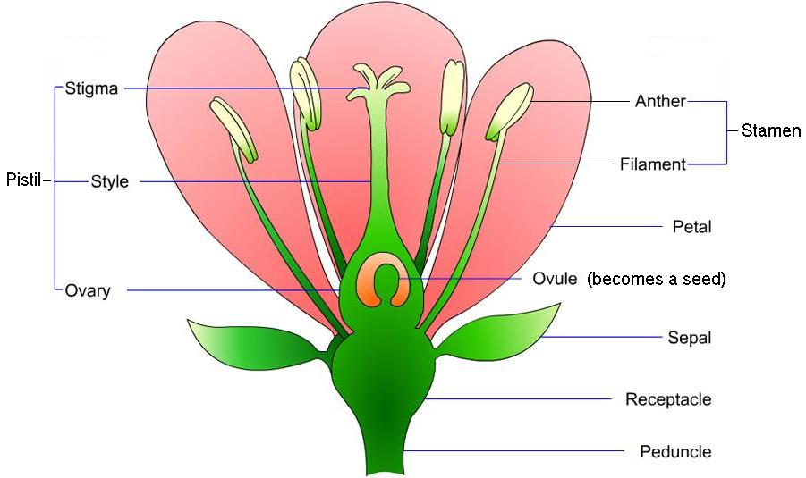
Female reproductive organ
Male reproductive organ
Pistil
*Stigma –top of the pistil,
Sticky surface for pollen to stick to
*Style – connects the stigma to the ovary
*Ovary –contains ovules
( eggs)
Stamen
*Anther – produces sperm nuclei by meiosis. Sperm nuclei are enclosed by pollen grains.
*Filament – holds the anther up

Slide 3
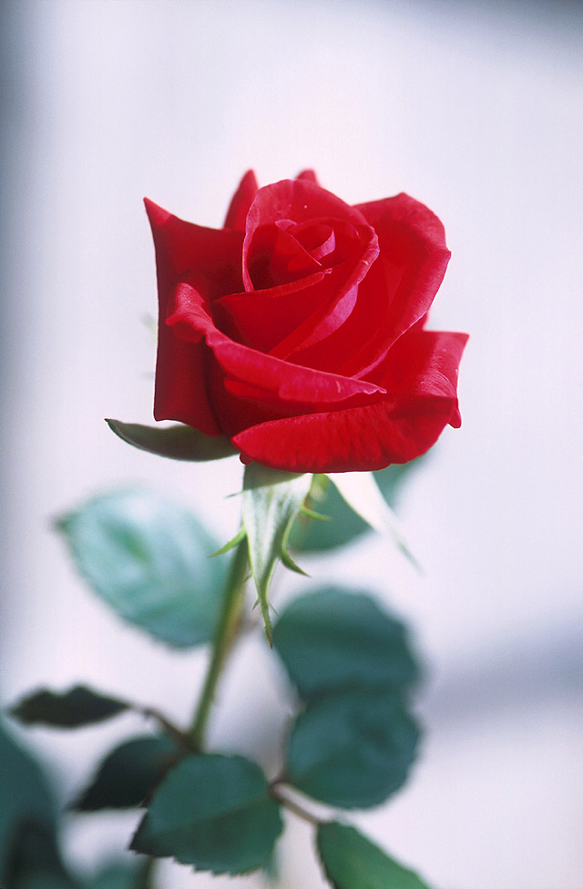
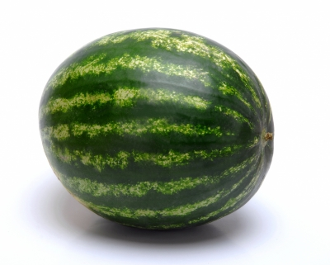
Bisexual Flowers
Bisexual Flowers have both male and female reproductive units, including stamens, carpels, and an ovary. Flowers that contain both androecium and gynoecium are called androgynous or hermaphroditic. Examples of plants with perfect or bisexual flowers include the lily, rose, and most plants with large showy flowers, though perfect flower does not have to have petals or sepals. Other terms widely used are monoclinous, and synoecious.
Unisexual
Unisexual Either functionally male or functionally female. In angiosperms this condition is also called diclinous, imperfect, or incomplete

Slide 4
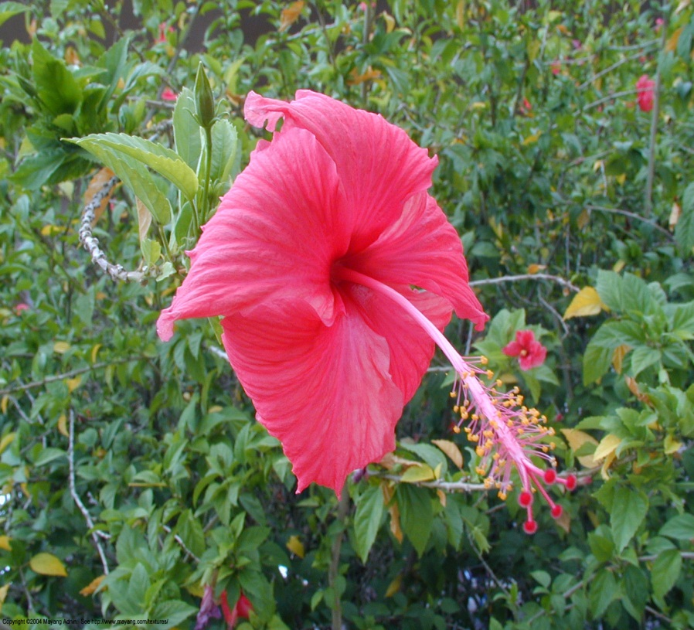
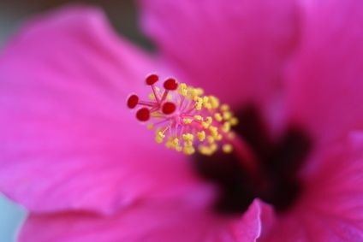
Reproductive organs
Stamen
The stamen is the pollen-producing male reproductive organ of a flower. Stamens typically consist of a stalk called the filament. It produces pollen grains that are yellowish in color .
Carpel
A carpel is the ovule and seed producing female reproductive organ in flowering plants. Carpels are derived from ovule-bearing leaves which evolved to form a closed structure containing the ovules.

Slide 5
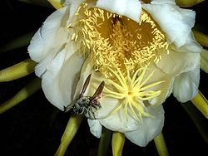
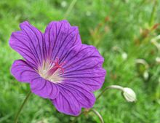
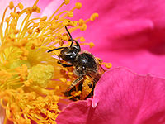
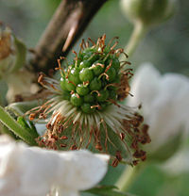
Pollination
Pollination is the process by which pollen is transferred in the reproduction of plants, thereby enabling fertilization and sexual reproduction. The transfer is achieved by agents like wind , water or animals
Self- Pollination
The transfer of pollen occurs in the same plant.
Cross –Pollination
The transfer of pollen from one flower to another

Slide 6
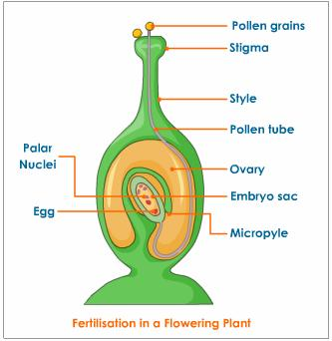
Fertilisation
The swollen bottam part of the carpel that is the ovary contains ovules and each ovule has an egg cell . The male germ – cell produced by pollen grains fuses with the female gamete present in the ovule . Fertilisation gives us the zygote which is capable of growing into a new plant . The pollen needs to be transferred from the stamen to the stigma

Slide 7
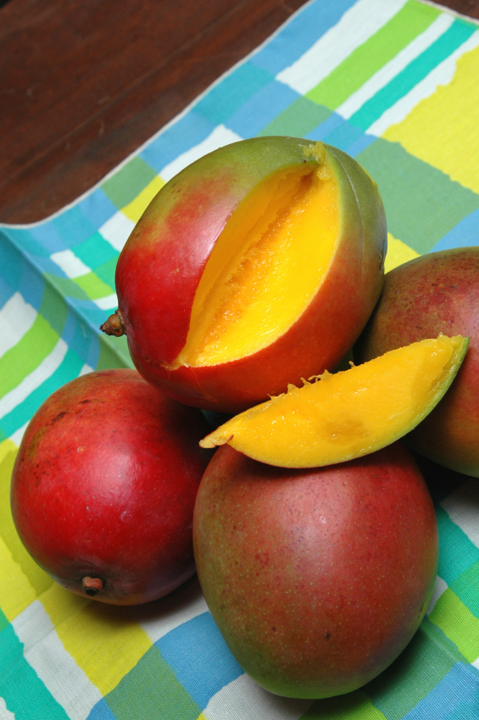
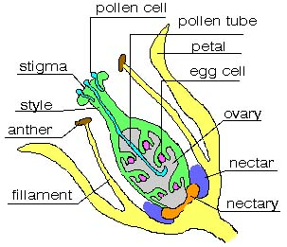
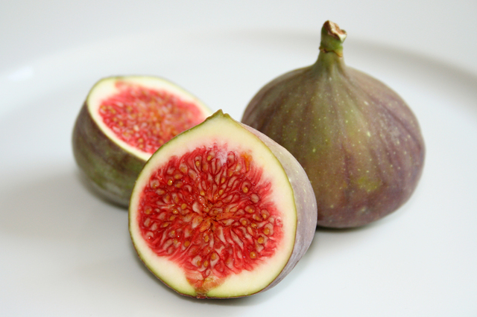
After the pollen lands on a stigma , it has to reach the female germ-cells which are in the ovary for this , a tube grows out of the pollen grain and travels through the style to reach the ovary.
After Fertilisation , the zygote divedes several times to form an embroyo within the ovule . The ovule develops a tough coat and is gradually converted into a seed . The ovary grows rapidly and ripens too form a fruit

Slide 8
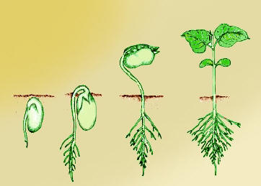
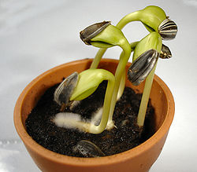
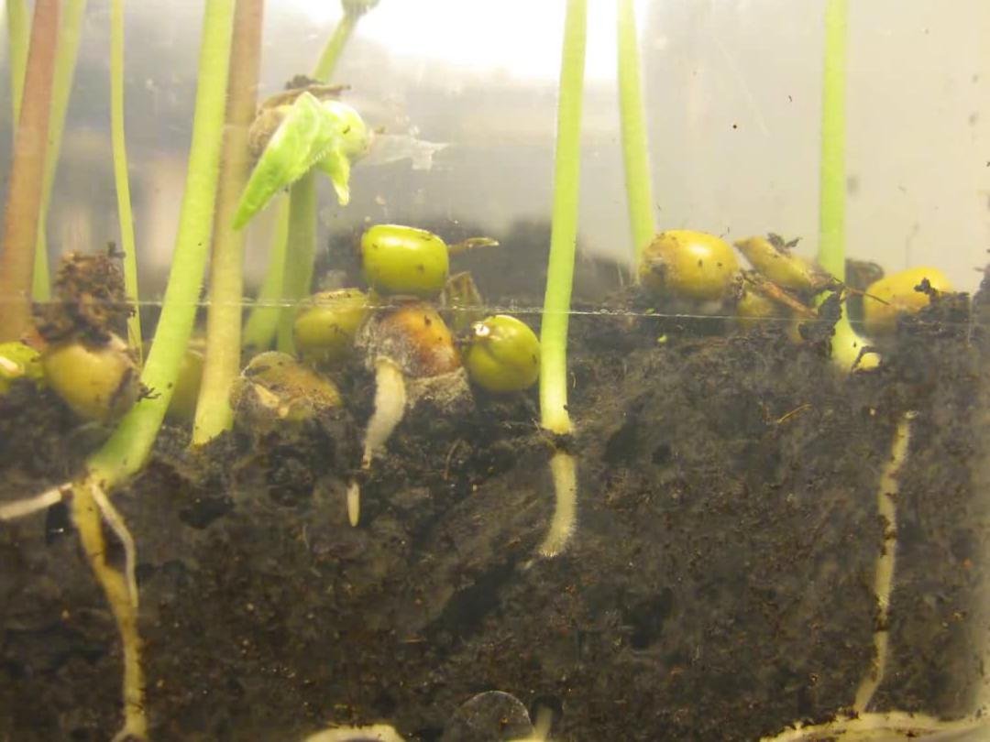
Germination
The seed contains the future plant which develops into a seedling under appropriate conditions
Some Of The Factors Are –
Water
Temperature
Oxygen
Light

Slide 9
The END

